Slide 1
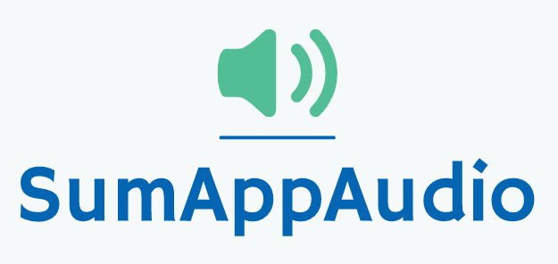
Third checkpoint
Group 4
Marco Carfora
Daniele Calisi
Francesco Bovi

Slide 2
Business concept
During the last years the awareness on the dyslexia is increased. Indeed, it has been registered a raise of students with certified dyslexia (177.000 cases in Italy), from 0.7% in 2010 to 3.2% in 2018 but the number is probably higher.
Students affected by dyslexia have difficulties in reading a text and troubles copying from the blackboard. They don’t have a way to easily grasp the concepts and to make the comprehension faster, indeed they usually need external help, like a tutor.
Sum-AppAudio is a mobile platform based on a student-to-student model to support the study of students with dyslexia. The core of the App are the recorded files that every student can upload to summarise subject topics or book chapters. The system is designed ad hoc to overcome the difficulties that students with dyslexia have to face but also other students can enjoy the service.

Slide 3
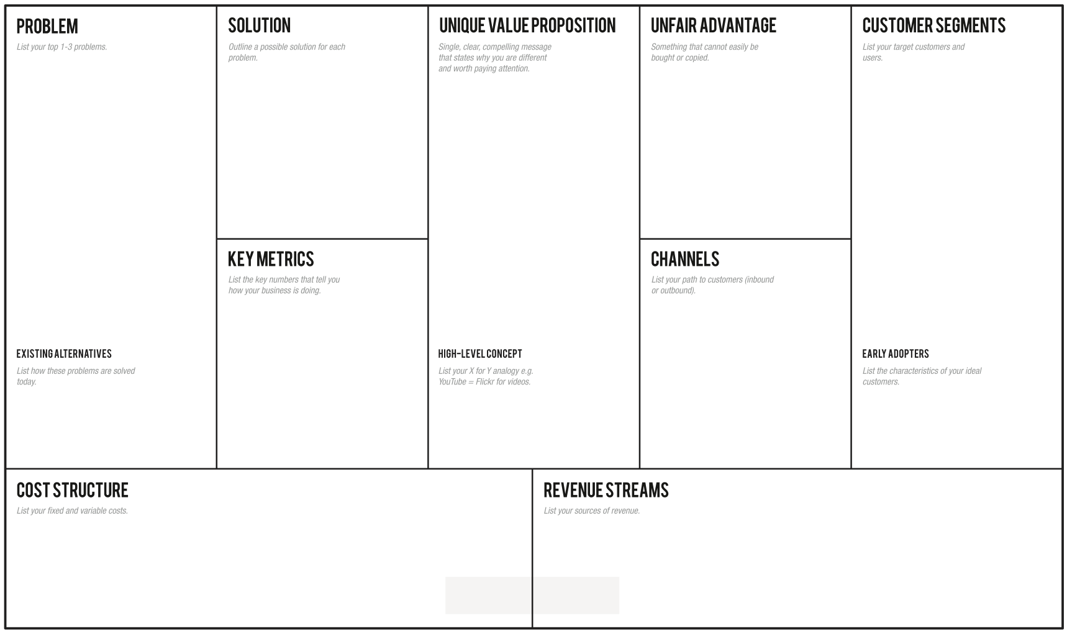
-Students with dyslexia have difficulties in reading and comprehending a text:
-They don’t have a way to easily grasp the concepts, making the learning slow.
-They need an easy way to autonomously review school subjects, indeed they usually ask for external help
Through the app the students can learn in an easier and efficient way, avoiding tiring readings, relying on recordings from a huge collection built thanks to a lot of students' support
Overcome your reading and learning difficulties, enjoy a student-to-student model whose core are the recorded files that every student can upload to summarise subject topics or book chapters for students with dyslexia.
-Students with dyslexia problems (2% from primary schools, 5.6% from middle schools, 4.7% from high schools).
-Schools and pedagogical associations -Support teachers.
-Every student who want to help other ones.
-Number of produced and listened recordings (monthly).
-Content quality trends thanks to feedback system.
-How many results appear for a single topic.
-How many people use the app regularly (rate of accesses)
-Flyers distribution in front of selected schools and associations of this sector.
-A social page dealing with dyslexia problem.
-Meetings in school where we present our project to students.
- Select classes with a dyslexic student in Rome schools, so classmates can help each other -Tutors / Support teachers
Skuola.net, ad hoc textbooks, Youtube, voice synthesizers, tutors, concept maps
Sum-AppAudio = Spotify for school summaries.
-Server/database maintenance;
-Channels’ cost;
- Cost of the application in the mobile store;
- Partnerships with schools/associations;
- Partnerships with publishing companies to certify their content;
- Banner advertisements;

Slide 4
Last week Validation Plan
Assumptions we have validated:
How:
The interest of dyslexic students and tutors to use the app;
The interest of non-dyslexic students to upload recorded files;
The usefulness of the audio model for dyslexic students; .
Surveys/questionnaires on social networks;
MVP: give audio files to dyslexic students verifying their comprehension quality;

Slide 5
Last week results analysis
New generations of students prefer electronic devices during the study than paper tools. Moreover, the use of PC is predominant, but the use of smartphone is increasing;
General study method satisfaction increased, but there are still some problematic issues;
90% of dyslexic students think that the App could be useful for them;
More contact with dyslexic students, therefore more will to help (even without rewards);
90% of tutors think that the App could be useful for students, moreover they will be available to certify the quality of some recordings;

Slide 6
Last week actions summary
The application should be developed both for PC and smartphone, not only on the latter as we initially thought
Remove: gift card (at least for the first period)
Add: guidelines for audio creators (specific titles, clear concepts, loud voice, short recordings, repetition of principal concepts, chronological order)
Add: optional concept maps together with the recordings
Add: show up authors nicknames

Slide 7
Validation Plan of this week
New assumptions to be validated:
How:
Usage of the App in terms of uploading and listening (frequency)
Revenue (App price, donations ... )
.
Surveys/questionnaires on social networks;

Slide 8
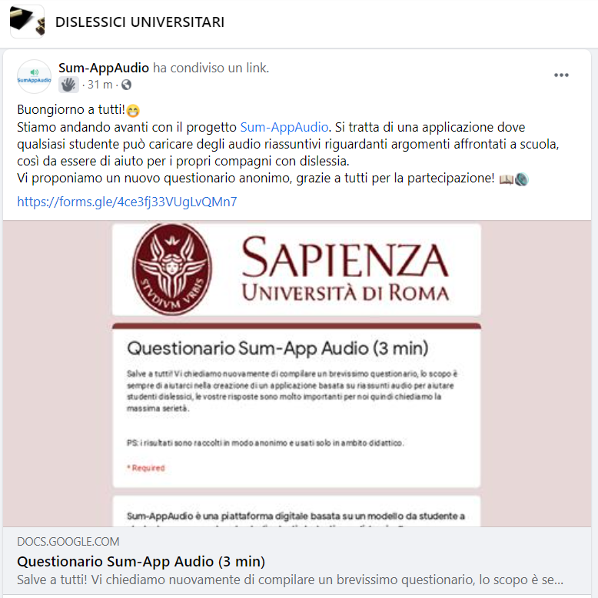
New Questionnaire
CONTENT SUMMARY:
Audio tools usage in the current state of art; (only for dyslexic)
Frequency of uploading and listening of the recorded content;
Usage of other competitors
Comments on audio tests
Economic questions (App price, donations..)
Addressed to: Scholars and ex-students, dyslexic and not.
Where: Our contacts, facebook groups about dyslexia.
Questionnaire Link: https://forms.gle/QuVuZAP4pvYhy48HA

Slide 9
Minimum Viable Product
Results until now:
The majority of people who listened the recordings answered with a positive feedback regarding the usefulness of it for dysliexic students. But there’s still a percentage that considered them not clear and gives us feedbacks to improve their quality.
Addressed to:
Dyslexic students;
Where:
Our contacts, questionnaire, Landing Page on Facebook;
What:
To verify the usefulness of the audio system for dyslexic students, we have provided them some audio recordings; they listened and gave us a feedback.
“Mettete oltre audio gli scritti e per quale scuola”
“Andare un po più lenti e fare ogni concetto spiegato una summa per seguire meglio”
“Consiglio di marcare meglio alcune parole chiave, nel senso di pronunciarle meglio poiché alcune volte non si è capito bene “

Slide 10
* to move from “Students” to “Dollars” we are waiting to establish the revenue streams
Students in the world
TAM
1 Bln Students*
Students in Italy
SAM
0.8% of TAM
Students in Rome (middle and high school) with a dyslexic in class
SOM
1,7% of SAM

Slide 11




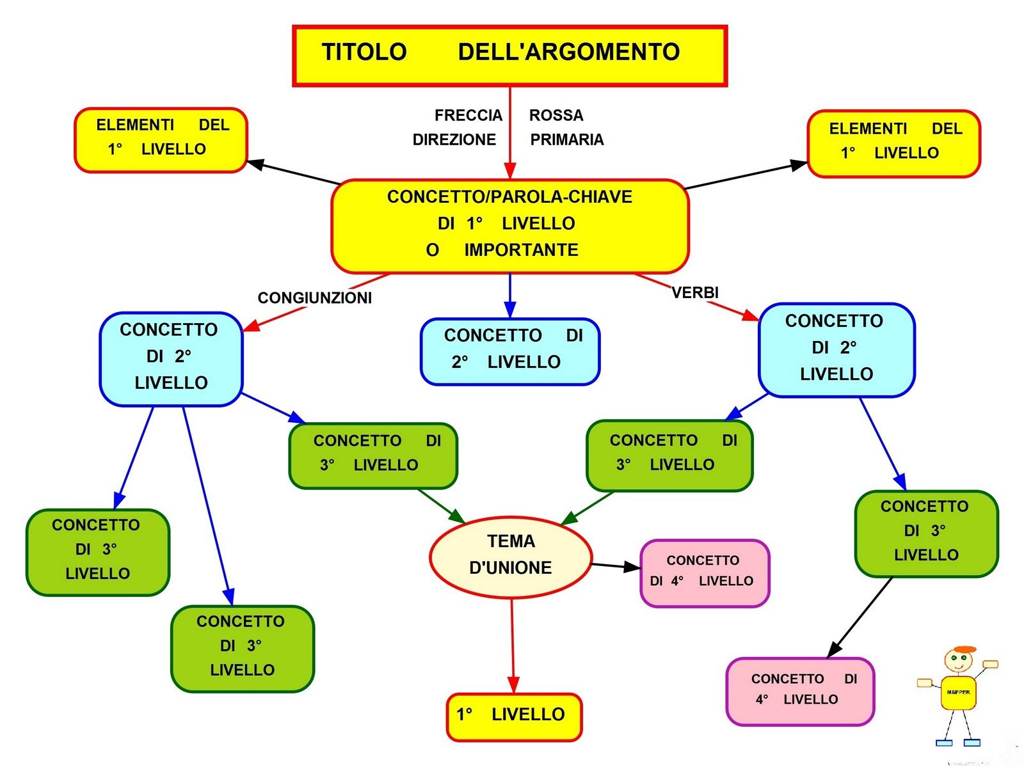

COMPETITOR ANALYSIS
Audio
media
Voice synthesizer
Concept maps
Ad hoc Textbooks
Ad hoc content for dyslexic students

Slide 12
Next steps:
MOCKUPS;
User Experience;
New questionnaire results analysis;

Slide 13
THANK
YOU!

